Slide 1
Work Session 1:
Introduction & Framework, and Assess Community Vulnerability
Planning for Hazards Working Group
[DATE]
Images and logos as appropriate

Slide 2

Meeting Overview
Project overview
Community goals and relevant projects underway
Frame the HIRA process
Assess community vulnerability
Develop problem statements
Next steps/final discussion
Have fun

Slide 3

Introductions
Your name
Your agency/department
Expertise you bring to the team
“Planning for hazards” wizard

Slide 4
Project Overview

Slide 5
Project Background
Insert relevant background (why you are doing this project)

Slide 6
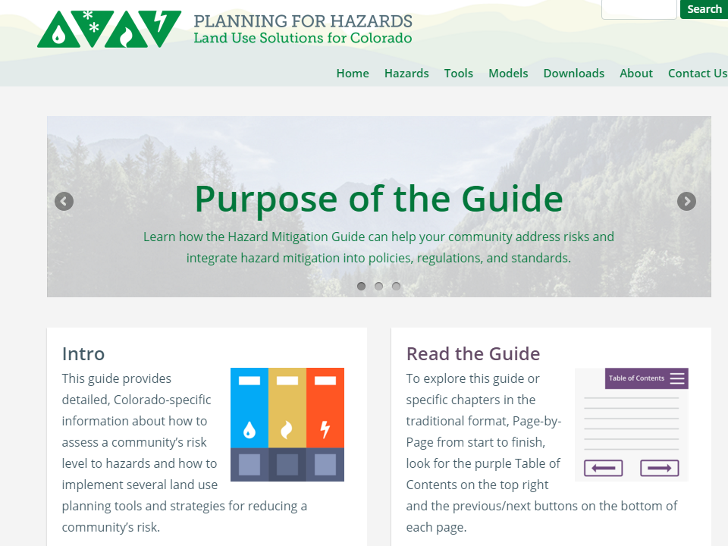

www.planningforhazards.com

Slide 7
An Emphasis on Planning
Addressing Hazards in Plans and Policies
Strengthening Incentives
Protecting Sensitive Areas
Improving Site Development Standards
Enhancing Administration and Procedures
This project will not directly address:
  Capital projects
  Infrastructure
  Building code
  Staffing and enforcement

Slide 8
So…How do we Get There?
12 Months
Up to five work sessions:
Introduction, assess vulnerability
Planning strategies and identifying planning tools
Prioritizing planning tools
Refining draft planning tools
Implementation and maintenance
Identify and Prioritize Implementation Tools
Develop and Refine Implementation Tools
Implementation and Maintenance

Slide 9

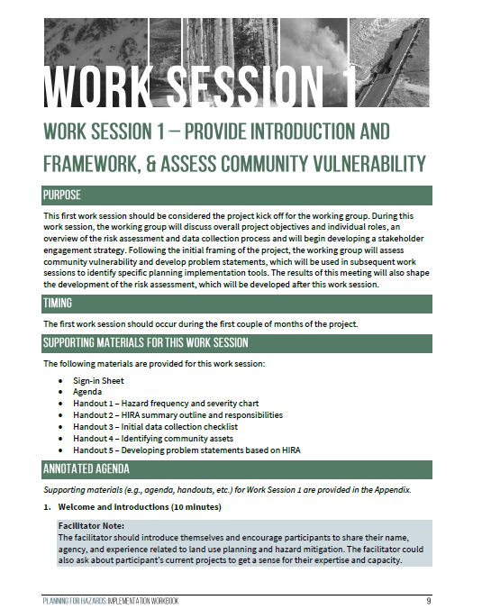
The Planning for Hazards Workbook

Slide 10

Role of the Working Group
Attend work sessions regularly
Provide guidance on approaches
Review draft materials and provide feedback
Be a local champion!
Report back to your respective agencies and/or others in the community

Slide 11
From [title of comp plan] to Action!
Moving the Plan Forward

Slide 12
Organizing Framework
How is the plan organized

Slide 13
Related Goals
What are the relevant goals from the plan?

Slide 14
Actions!
What are the relevant actions or strategies from the plan?

Slide 15
Planning Tool Profiles (from the Guide)
Comprehensive Plan
Climate Plan
Community Wildfire Protection Plan
Hazard Mitigation Plan
Parks and Open Space Plan
Pre-Disaster Planning
Community Rating System
Density Bonus
Development Agreement
Transfer of Development Rights
1041 Regulations
Cluster Subdivision
Conservation Easement
Land Acquisition
Overlay Zoning
Stream Buffers and Setbacks
Stormwater Ordinance
Site-Specific Assessment
Subdivision and Site Design Standards
Use-Specific Standards
Building Code
Critical Infrastructure Protection
Wildland-Urban Interface (WUI) Code
Application Submittal Requirements
Post-Disaster Building Moratorium

Slide 16
Current Relevant Projects Underway
What other efforts could inform or be informed by this project?

Slide 17
The Risk Assessment Process
Overview and Key Issues

Slide 18
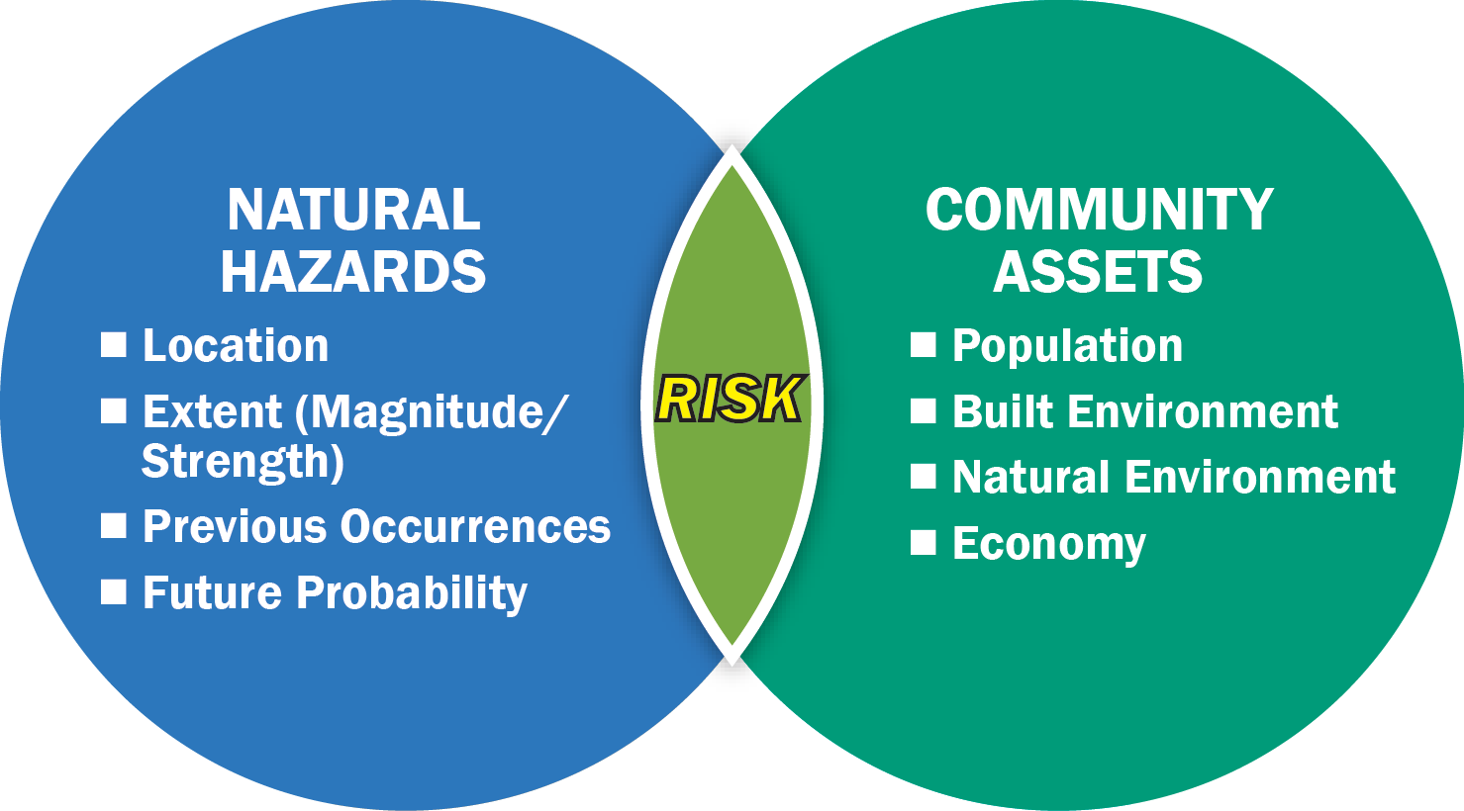
Risk Assessment
1. Describe Hazards
2. Identify Community Assets
3. Evaluate impacts & potential losses
4. Summarize key issues & vulnerabilities
Note: FEMA Local Mitigation Planning Handbook and adapted from U.S. Geological Survey and Oregon Partnership for Disaster Resilience Models

Slide 19
Local Hazards from the Hazard Mitigation Plan
If there is a hazard mitigation plan – identify the hazards
Discuss key components of the plan
If there is NOT a plan, then the community may create one through this process.

Slide 20
Vulnerability Assessment
Either taken from existing Hazard Mitigation Plan, or developed as part of this project

Slide 21
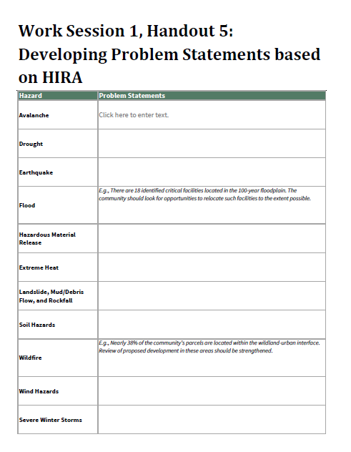
Develop Problem Statements
Based on vulnerability assessment, lead an exercise on developing problem statements.

Slide 22
Stakeholder Engagement
Developing a Strategy

Slide 23
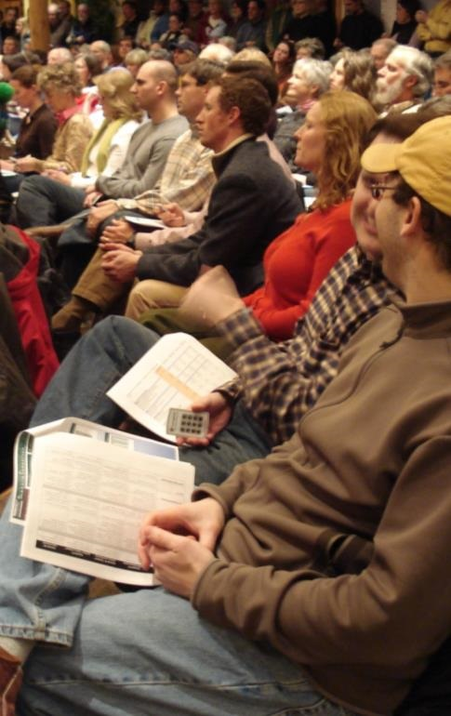
Who Should be Engaged?
Appointed and Elected Officials?
Department Heads?
Other Agencies?
Focus Groups?
  Developers
  Business owners
  Neighborhoods
The General Public?

Slide 24
When Should They be Engaged?
Key Milestones:
Following kickoff
Draft planning implementation tools
Adoption process

Slide 25
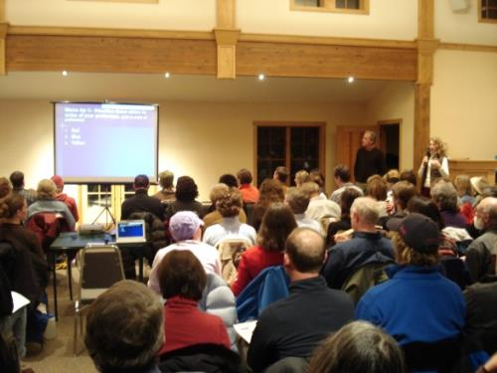
How Should They be Engaged?
Informational meetings
Surveys
Study session/work session
Media outreach
City website
Listserv
Interviews
Mailings
What has worked well in the past?
Any challenges?

Slide 26
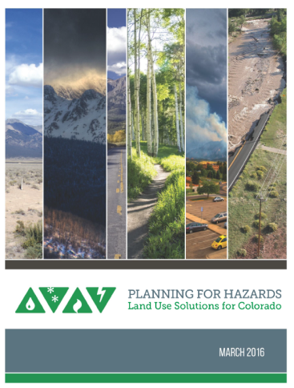
Next Steps
Work Session 2 – [insert date]
Discuss local risk assessment [if applicable]

Slide 27
Thank You
Insert contact info
Images and logos as appropriate

