Slide 1
Work Session 3:
Prioritize Planning Implementation Tools
Planning for Hazards Working Group
[DATE]
Images and logos as appropriate

Slide 2

Meeting Overview
Recap Work Session 2
Discuss draft assessment memorandum
Planning implementation tools prioritization exercise
Next steps/final discussion
Have fun

Slide 3
Where Are We Now?
12 Months
Up to five work sessions:
Introduction, assess vulnerability
Planning strategies and identifying planning tools
Prioritizing planning tools
Refining draft planning tools
Implementation and maintenance
Identify and Prioritize Implementation Tools
Develop and Refine Implementation Tools
Implementation and Maintenance

Slide 4
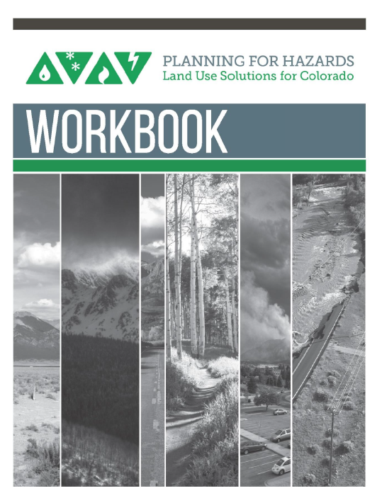
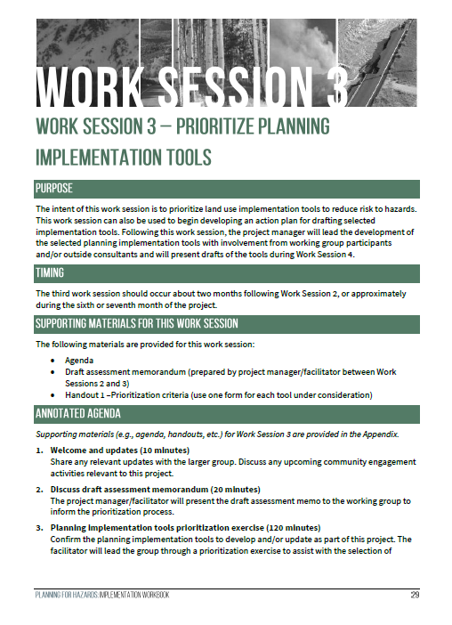
The Planning for Hazards Workbook

Slide 5
Discuss Draft Assessment Memo
Share results of the draft assessment memo, if applicable

Slide 6
Planning Tool Profiles (from the Guide)
Comprehensive Plan
Climate Plan
Community Wildfire Protection Plan
Hazard Mitigation Plan
Parks and Open Space Plan
Pre-Disaster Planning
Community Rating System
Density Bonus
Development Agreement
Transfer of Development Rights
1041 Regulations
Cluster Subdivision
Conservation Easement
Land Acquisition
Overlay Zoning
Stream Buffers and Setbacks
Stormwater Ordinance
Site-Specific Assessment
Subdivision and Site Design Standards
Use-Specific Standards
Building Code
Critical Infrastructure Protection
Wildland-Urban Interface (WUI) Code
Application Submittal Requirements
Post-Disaster Building Moratorium

Slide 7
Land Use Tool Prioritization Exercise

Slide 8
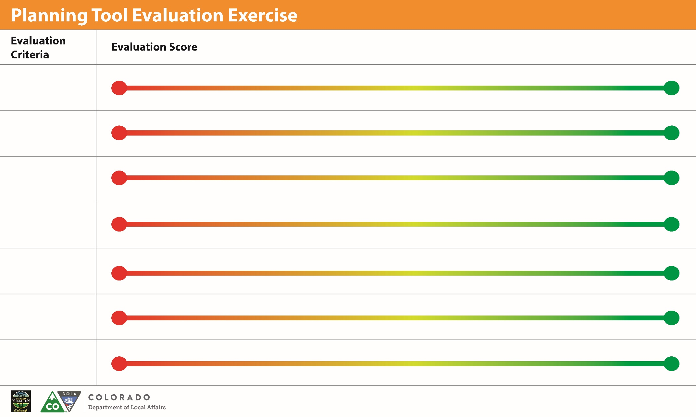
Tool 1
Effective Risk Reduction
Tool 2
Administrative Capability
Tool 3
Political and Public Support
Tool 4
Benefits vs. Costs
Tool 5
Alignment w/ Community Goals
Tool 6
Social Equity
Tool 7
LEGEND:

Slide 9
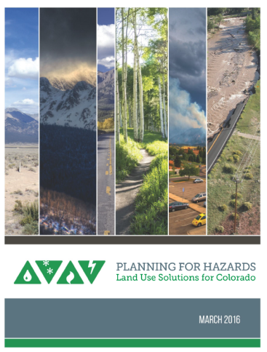
Next Steps
Work Session 4 – [insert date]

Slide 10
Thank You
Insert contact info
Images and logos as appropriate

