Slide 1
Work Session 4:
Review and Refine Planning Implementation Tools
Planning for Hazards Working Group
[DATE]
Images and logos as appropriate

Slide 2

Meeting Overview
Review draft implementation tools
Develop outreach strategy and process for approval and/or adoption
Next steps/final discussion
Have fun

Slide 3
Where Are We Now?
12 Months
Up to five work sessions:
Introduction, assess vulnerability
Planning strategies and identifying planning tools
Prioritizing planning tools
Refining draft planning tools
Implementation and maintenance
Identify and Prioritize Implementation Tools
Develop and Refine Implementation Tools
Implementation and Maintenance

Slide 4

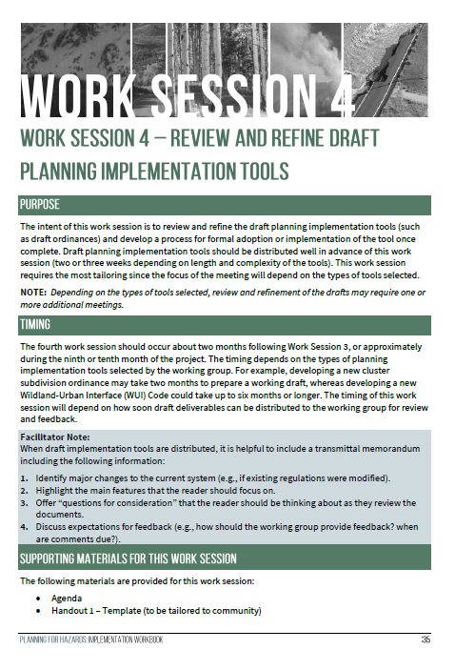
The Planning for Hazards Workbook

Slide 5
Review Draft Implementation Tools
Slides on draft implementation tools as necessary

Slide 6
Recommendations
Reminders of recommendations from plans
Reminders of recommendations from assessment report

Slide 7
Public feedback
Include any initial public feedback received on the tools (if applicable)

Slide 8
Refining Stakeholder Engagement

Slide 9

Who Should be Engaged?
Appointed and Elected Officials?
Department Heads?
Other Agencies?
Focus Groups?
  Developers
  Business owners
  Neighborhoods
The General Public?

Slide 10
When Should They be Engaged?
Key Milestones:
Draft planning implementation tools
Adoption process

Slide 11
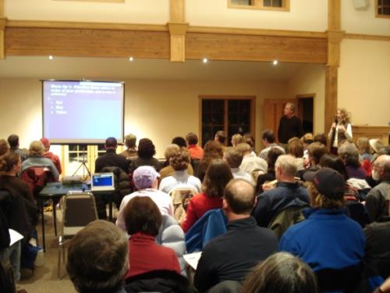
Upcoming Engagement Opportunities
Informational meetings
Surveys
Study session/work session
Media outreach
City/town website
Listserv
Interviews
Mailings

Slide 12

Next Steps
Work Session 5 – [insert date]

Slide 13
Thank You
Insert contact info
Images and logos as appropriate

